Slide 1
SCSA SC2001 Lab
Example Class
Project 1 Team 7
PU FANYI (U2220175K)
PUSHPARAJAN ROSHINI (U2222546A)
QIAN JIANHENG OSCAR (U2220109K)
RHEA SUSAN GEORGE (U2220116B)

Slide 2
Implementation of Hybrid Sort
Split
Threshold S has been hit
Insertion sort
Merge

Slide 3
Implementation
compare_count_t mergeSortWithInsertionSort(int *begin, const int *end, const int threshold) {
compare_count_t compareCount = 0;
const size_t size = end - begin;
if (size <= threshold) {
compareCount += insertionSort(begin, end);
} else {
int *mid = begin + size / 2;
compareCount += mergeSortWithInsertionSort(begin, mid, threshold);
compareCount += mergeSortWithInsertionSort(mid, end, threshold);
compareCount += merge(begin, mid, end);
}
return compareCount;
}

Slide 4
Random data generation
Multiple test and get the average.
Mersenne Twister
typedef compare_count_t (*SortFunction)(int *begin, const int *end, ...);
EvaluationResult evaluate(SortFunction sortFunction,
const int *array_begin, const int *array_end, ...) {
size_t array_size = array_end - array_begin;
int *array_copy = (int *) calloc(array_size, sizeof(int));
memcpy(array_copy, array_begin, sizeof(int) * array_size);
va_list args;
va_start(args, array_end);
clock_t begin = clock();
compare_count_t compareCount = sortFunction(array_copy, array_copy + array_size, *args);
clock_t end = clock();
EvaluationResult result;
result.time = end - begin;
result.compareCount = compareCount;
result.correctness = isSorted(array_copy, array_copy + array_size);
free(array_copy);
return result;
}
Notes:
Purpose : to make it more random

Slide 5









Theoretical Analysis (Hybrid Sort)
Layers
0
1
2
k
From lecture,
=

Slide 6
Part i : Fixed S, Vary n
How we approached :
With fixed S threshold of 16, and input size ranging from 1,000,000 to 50,000,000
S = 16 is randomly generated
For every size n input, each data point is curated by taking average of 5 random runs
50 n,CompareCount and time data results generated
Key Comparisons vs Input n sizes & Input n sizes vs Time plotted
Notes:
Everytime data is generated when we test - we are changing the array : so it becomes unstable
Theoretically, we should run each set a lot of times - we only ran thrice or 5 times, so maybe run like maybe 100 times to produce more accurate results
Cannot keep changing the array when we un
Pdf says 1000 to 10,000,00??

Slide 7
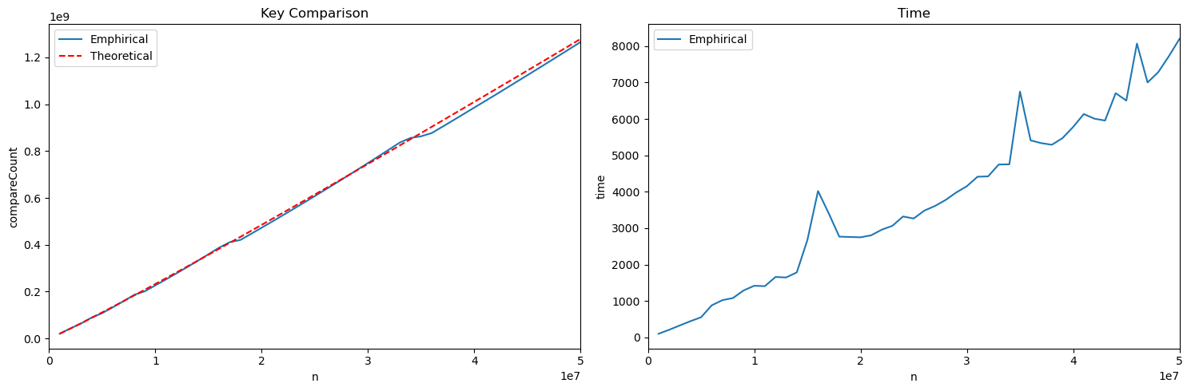

Key comparison vs Different Input n
Shape of theoretical analysis largely matches the emphirical results
Theoretical analysis is derived from :
theoretical_values = n_values*np.log2(n_values/16) + 1/4 *16*n_values
Notes:
Adjust scale done
Supposed to be a more curved gradual increase
Threshold on what basis 16? random
https://deepnote.com/@grace-tong/Algo-Lab-1-Hybrid-Merge-Sort-3151e5f8-170b-46a3-b108-6db725e310c3
https://github.com/Ry3nG/Hybrid-Sort-based-on-Insertion-Sort-and-Merge-Sort

Slide 8
Possible deviations in the time complexity :
Variations in Input Size
Array size is changing whenever new input n size is generated → unstable
CPU Distractions
Notes:
Input size varies dynamically during algo execution, so time complexity can become unstable, in case where input size significantly fluctuates, algo perf vary accordingly → unpredictable execution times
CPU's performance can be affected by concurrent operations running on the same system. when the CPU is distracted by other tasks or processes, it may cause spikes in the observed time complexity of the algorithm.

Slide 9
Part ii: Fixed n, Vary S
Our approach:
Generate 5 array with random values of same size, n
Run the hybrid sort with S value from 1 to 126 on the 5 array
Take the average key comparison and time taken
Note*: To simulate the Average case, ideally we should run the Hybrid sort with each S on many arrays.
Notes:
Stable, av case doesnt matter : cos running on same array

Slide 10
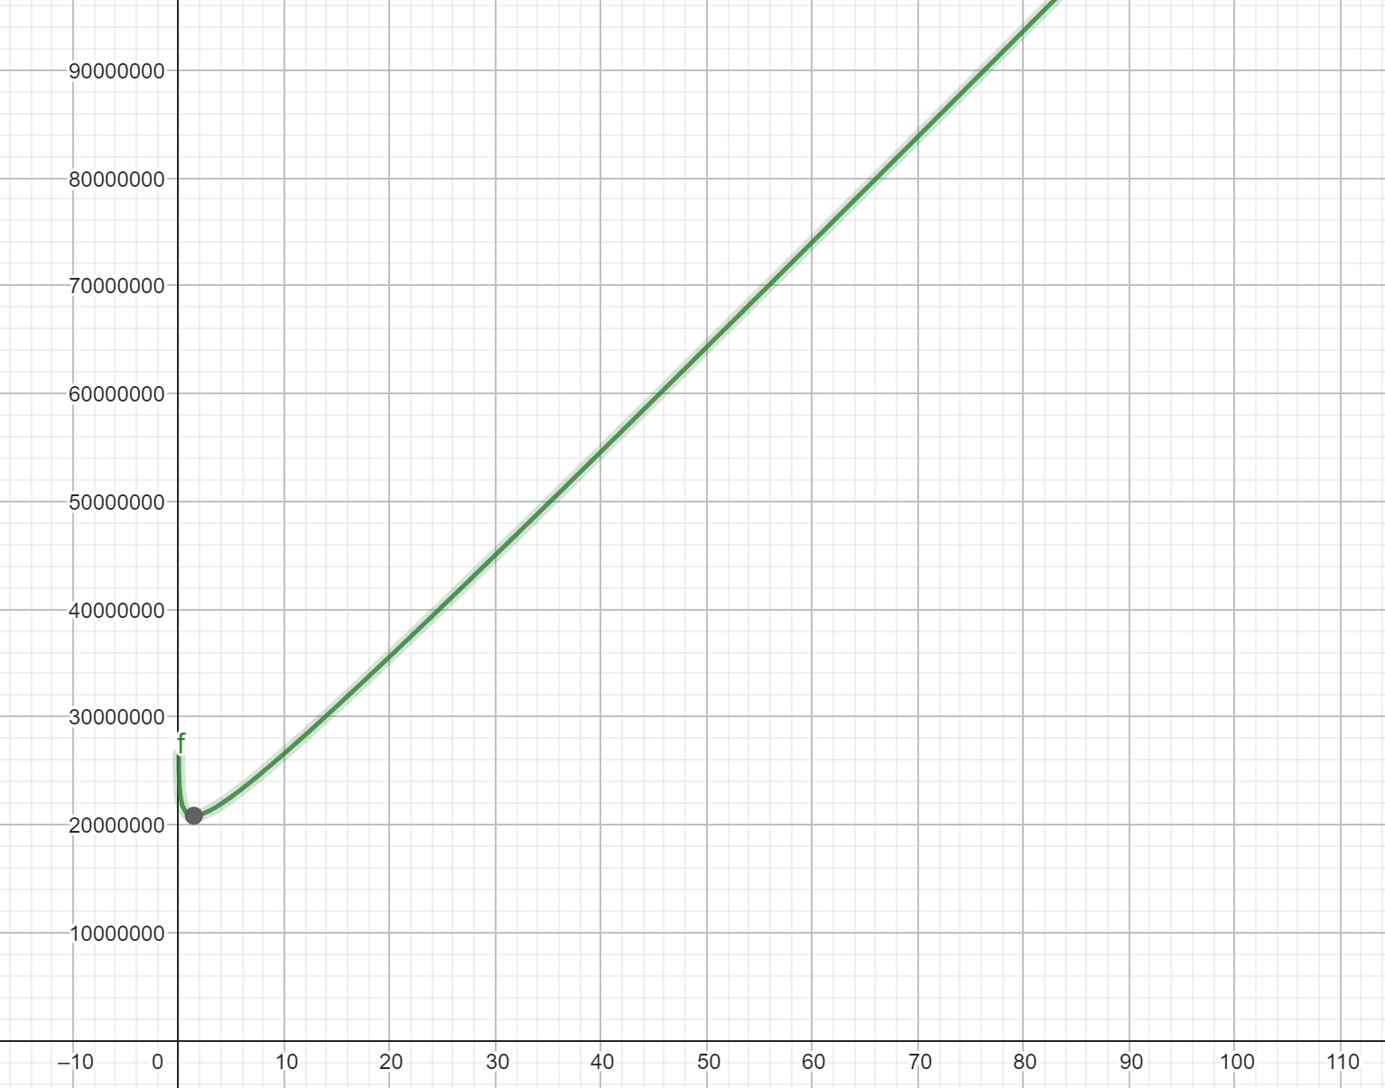
Theoretical analysis (Key comparison)
Average case: Insertion Sort => O(n²) Merge Sort => O(nlogn)
Hypothesis: Key comparison should increase as S increases
Expected Graph:

Slide 11
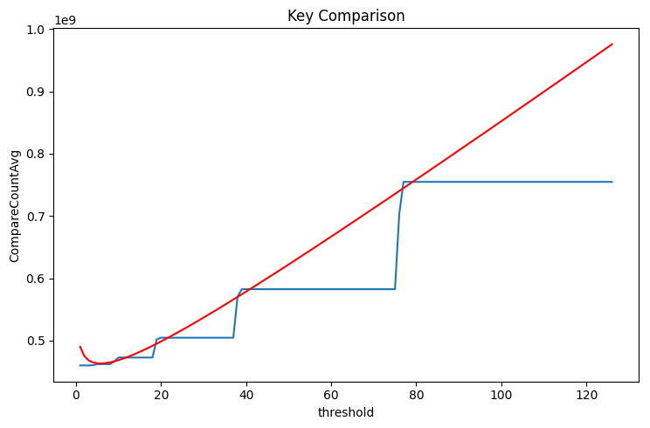
Actual result
Theoretical
Empirical

Slide 12
Actual Result
10 million
↓
5 million
↓
…
↓
152
↓
76
↓
38
↓
19
↓
…
↓
1
S = 76, 77, 78, …, 151 will all be still running on array on same size (76)
S = 38, 39, 40, …, 75 will all be still running on array on same size (38)

Slide 13
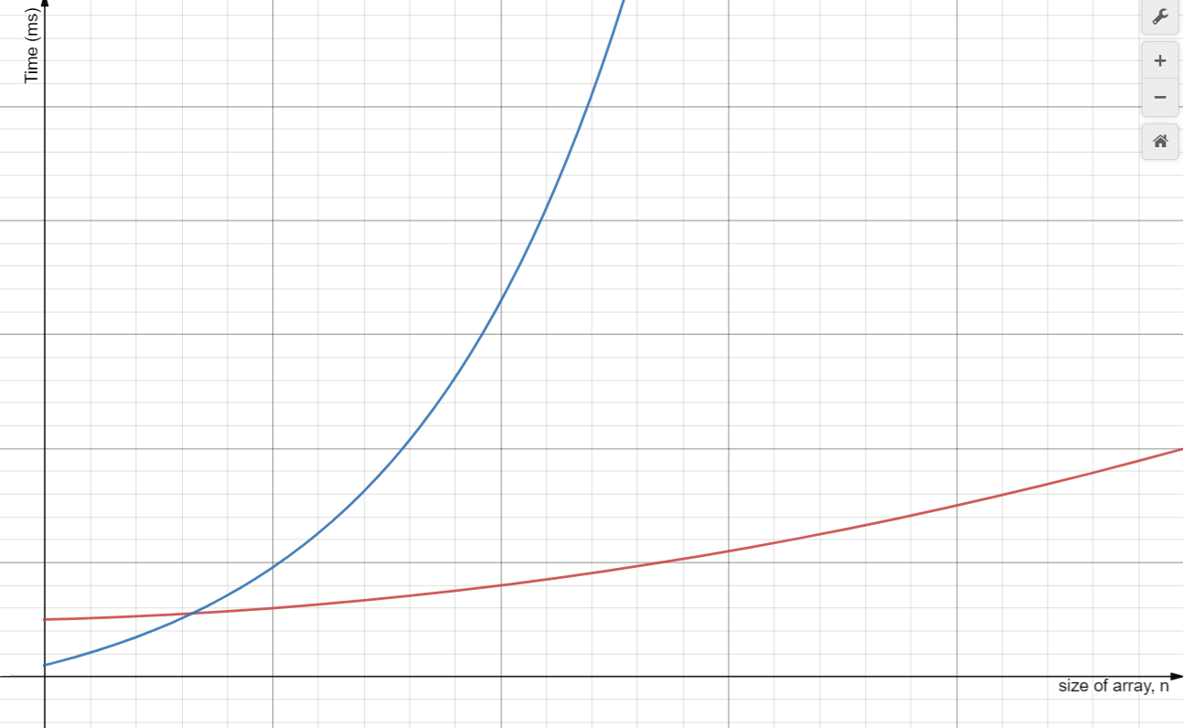


Theoretical Analysis (Time)
Insertion Sort:
Merge Sort:
Since C₂ > C₁,
When n is small, performance of
Merge sort is worse than Insertion sort
Insertion Sort
Merge Sort

Slide 14
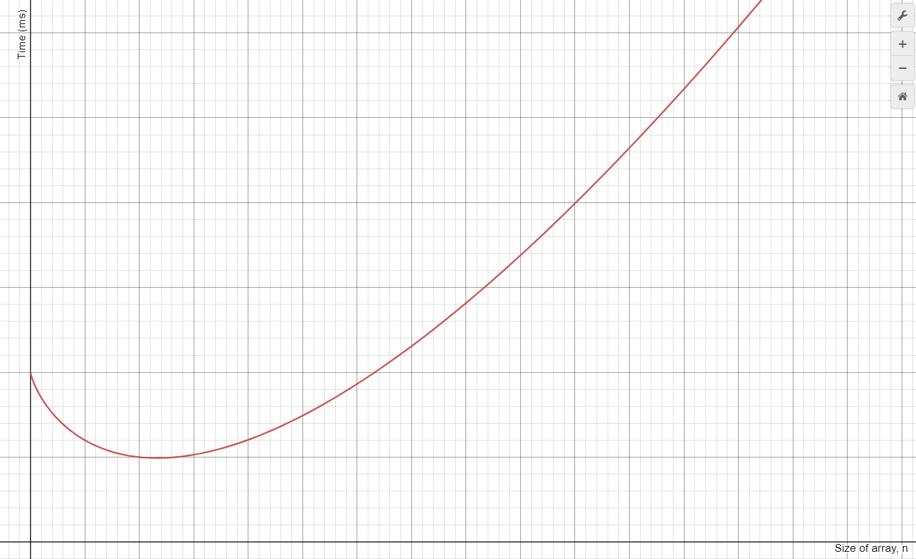
Hypothesised Graph for Hybrid Sort
Threshold, S
When performance of merge sort = performance of insertion sort
Notes:
This is basically the total time at each threshold, therefore you can't really see when it is purely insertion. But we know at threshold 0 it is purely mergesort. Therefore at the minimum point of the graph the dip is the optimum time the shortest time. Whereas the intersection is when merge sort and performance of insertion sort is the same

Slide 15
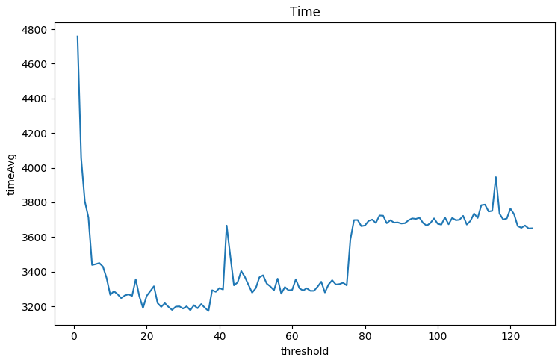
Actual Result
Optimal S for this n
Notes:
When S = 0, the algo is pure merge sort, which means that the time taken for merge operations after splitting into array of very small n is very large
Thats after adding the insertion sort component, the performance improved significantly as the insertion sort is now sorting the part where n is small. Then we can see that as threshold increase further, the performance worsens because insertion sort’s performance worsens exponentially.

Slide 16
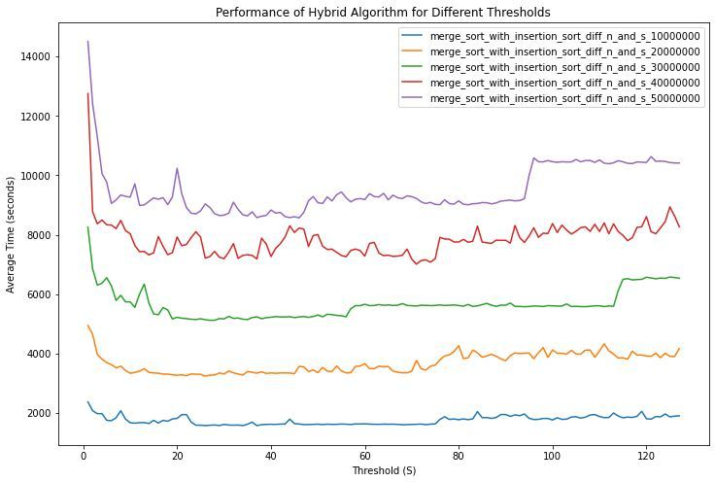
Part iii:Vary n and S
Our approach:
1. part ii, run against 5 different n values
2. The 5 different data sets is plotted into one graph
3. Optimal S derived from the graph
Notes:
In order to find the optimal s we did the same for part ii, but for 5 different size of n: 10mil, to 50 mil and compared the graph and through observation, the optimal S is around 35-40.

Slide 17
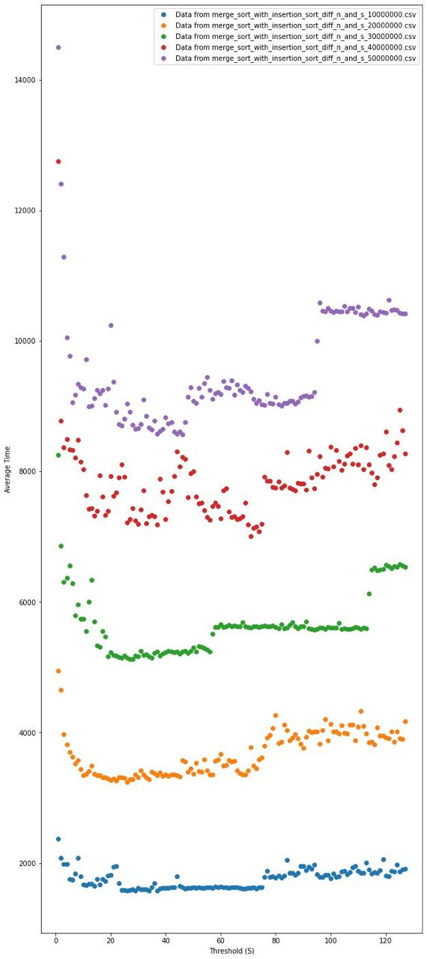
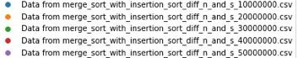
Results
Notes:
From the Plotted graphs by observation the optimal threshold would be around 35-40. I calculated the minimum optimum s value among the 5 n values which was 37 while the
Average of all the optimum s calculated through a quadratic best fit was 41, therefore the point seemed to be in between the range of 35-41 therefore we settled with observation, to demonstrate a better comparison

Slide 18
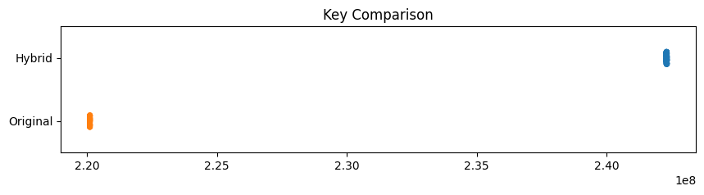
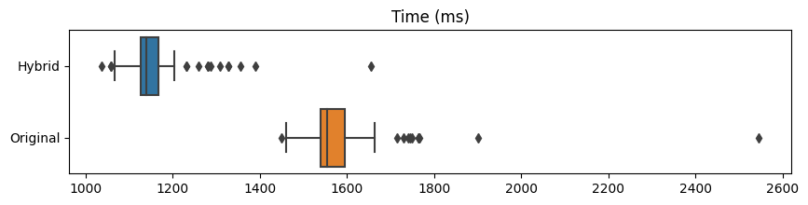
Evaluation Hybrid vs Original with S = 37
Approximate Percentage gain = 26.72%
(CPU time)
Notes:
Approximate Percentage gain = ?
Comparisons and CPU time of hybrid merge sort is higher than that of original merge sort at optimal value of 37

